Slide 1
India GCC Landscape
Strategic Analysis for Financial Services
[Presenter Name]
[Professional Title]

Slide 2


GCC Market Overview
India hosts over 1800 GCCs, employing approximately 1.9 million professionals and generating $65 billion in revenue, establishing itself as a key player in the global financial services landscape.

Slide 3

Location Comparison: Four Hubs
Market Share
Cost Efficiency
Talent Pool
Bangalore leads with 42% of the market share, hosting major financial institutions and a robust ecosystem for GCC operations, making it a top choice for investment.
Hyderabad offers competitive rents that are 20-30% lower than Bangalore, attracting new GCCs and fostering rapid growth in the region's financial services sector.
Pune boasts the highest retention rates and exceptional graduate employability at 84%, ensuring a skilled workforce that meets the demands of evolving financial services.

Slide 4

Bangalore: Established Leader
Bangalore is home to over 870 GCCs and commands a 42% market share in India's financial services, attracting major players like Goldman Sachs and JP Morgan.

Slide 5

Hyderabad: Fastest Growing
Hyderabad has become a thriving hub for GCCs, attracting investments with competitive rents and rapid establishment of new centers, positioning itself as a formidable challenger in the financial services landscape.

Slide 6

Pune: High Retention Hub
Pune has over 250 GCCs, renowned for their exceptional retention rates and an impressive 84% graduate employability, making it a prime location for engineering talent in India.

Slide 7

Delhi NCR Overview
Delhi NCR stands as a financial services powerhouse, boasting over 300 GCCs, the best international airport, and an extensive 394 km metro network ensuring seamless connectivity across the region.

Slide 8
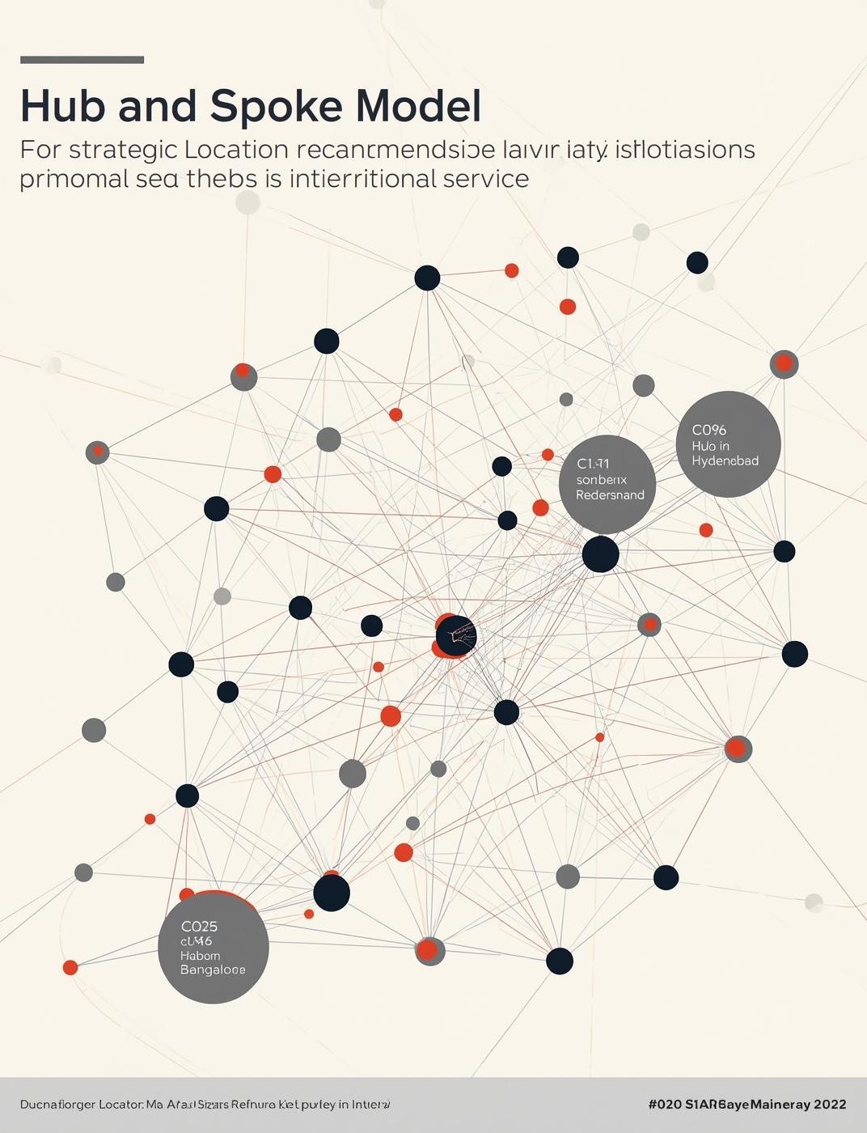
Strategic Location Model
The Hub and Spoke Model emphasizes Bangalore and Hyderabad as primary hubs, ensuring operational resilience and efficient resource allocation across connected centers for financial services.

Slide 9

GCC Model vs Third-Party Providers
Cost Control
Innovation Capacity
The GCC model offers greater cost efficiency through direct management of operational expenses, enabling organizations to maintain tighter budget control compared to third-party service providers.
GCCs are positioned to foster greater innovation, leveraging in-house talent and resources to accelerate development cycles and enhance technological capabilities, unlike third-party providers with limited integration.

Slide 10

Long-Term Value
Strategic Advantages of the GCC Model
Breakeven Timeline
Cost Decline
Innovation Output
The GCC model achieves breakeven within 2 to 3 years, enabling organizations to recover initial investments quickly while establishing a stable operational foundation.
Following breakeven, companies can expect annual cost reductions of approximately 20 percent, significantly enhancing financial performance and resource allocation for innovation and growth.
GCC operations tend to generate 3.2x more patents compared to traditional models, fostering a culture of innovation that drives competitive advantage and long-term sustainability.

Slide 11

Third-Party Risks
This section analyzes the strategic risks associated with third-party providers, highlighting the significant impact of outsourcing failures and data breaches on financial services organizations.

Slide 12
Recommended Operating Model
Core Functions
Centralizing critical operations within the GCC framework.
BOT Adoption
Increasing Build-Operate-Transfer models for efficiency gains.
Emphasizing a Hybrid Approach Strategy
Cost Control
Implementing strict budget management for resource optimization.
Talent Utilization
Enhancing skills through targeted training and development programs.

Slide 13
GCC Branding & EVP
Talent Sourcing
60% of GCC hiring is from other GCCs.
Addressing the Talent Acquisition Challenge
AI & ML Demand
Current AI/ML supply meets only 49% of demand.
Employee Retention
High turnover rates affect operational stability significantly.
Competitive Advantage
A strong EVP increases attraction and retention of talent.

Slide 14
Building a Compelling EVP
Clear Value Proposition
Career Development Opportunities
Inclusive Culture
Foster a diverse workplace that values all perspectives and backgrounds.
Clearly articulate the unique value offered to employees.
Provide structured pathways for career progression and growth.
Work-Life Balance
Recognition and Rewards
Promote policies that support flexibility and employee well-being.
Implement programs to acknowledge and reward employee contributions.

Slide 15
Strengthening Branding Strategies
Employee Advocacy
Consistent Messaging
Visual Identity
Engaging employees to promote the brand enhances credibility and reach.
Clear, uniform messages across platforms reinforce brand identity and values.
Strong visual elements cultivate recognition and trust among stakeholders.
Customer Experience
Community Engagement
Positive experiences lead to brand loyalty and favorable word-of-mouth.
Active participation in community initiatives strengthens brand reputation and loyalty.

Slide 16
Case Studies
01
02
03
Goldman Sachs
JP Morgan
Barclays
Home to over 50,000 professionals.
Employing more than 14,000 individuals.
Over 9,000 employees in India.

Slide 17


Key Recommendations & Sources
1. Optimize Multi-City Location Strategy
Hub-and-spoke model: Bangalore/Hyderabad primary + Pune/Delhi NCR satellite centers
2. Establish GCC with Hybrid Operating Model
GCC for core strategic functions + selective outsourcing via BOT model for speed
3. Invest in Differentiated EVP & Employer Brand
Sources: Zinnov, NASSCOM, ANSR, McKinsey, EY, Gartner, Everest Group, JLL, CBRE, Aon, Mercer, Deloitte, Randstad, Colliers, Karat, FINMA, Securiti (44 references)

Slide 18
Sources and References
GCC Landscape & Market: Zinnov (zinnov.com) | NASSCOM (nasscom.in) | ANSR (ansr.com) | Everest Group (everestgrp.com) | Flexiple (flexiple.com) | JLL (jll.com) | CBRE (cbre.co.in)
Strategy & Innovation: McKinsey (mckinsey.com) | EY (ey.com) | Deloitte (deloitte.com)
Salary & Compensation: Aon (aon.com) | Mercer (mercer.com) | AIM Research (aimresearch.co) | Zyoin (zyoin.com)
Branding & EVP: Gartner (gartner.com) | SPAG FINN Partners (spag.asia) | ANSR (ansr.com) | Randstad REBR 2025 (randstad.in) | Universum (universumglobal.com) | AIHR (aihr.com)
Real Estate: Anarock (anarock.com) | Brigade Group (brigadegroup.com) | Cushman & Wakefield (cushmanwakefield.com)
Talent: Colliers (colliers.com) | Karat (karat.com) | Careernet (careernet.in) | Taggd (taggd.in) | Gallup (gallup.com)
Government Policies: Karnataka GCC Policy 2024-2029 | Telangana ICT Policy 2021-2026 | Maharashtra GCC Policy 2025 | UP GCC Policy 2024 | Haryana GCC Policy 2025
Regulatory: Securiti (securiti.ai) | FINMA (finma.ch) | Cyria Amarchand Mangaldas
Case Studies: Goldman Sachs (goldmansachs.com) | JP Morgan (jpmorgan.com) | Deutsche Bank (db.com) | Barclays (barclays.bank.in)
Quality of Life: Mercer QoL Ranking 2024 | Numbeo (numbeo.com)

